Slide 1
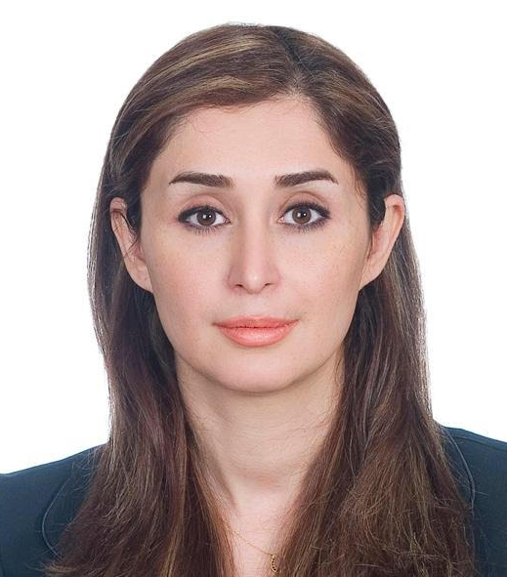
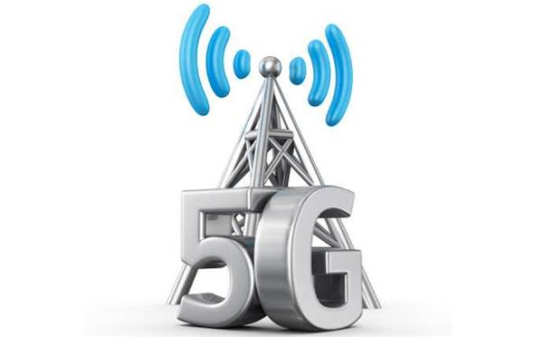
Having graduated with a bachelor’s degree in Electrical and Electronics Engineering, I started work at the Telecommunications Company of (Fixed-lines). To develop in my career, I then worked at the Mobile Telecommunications which led to me becoming a telecommunications expert. I have enhanced my knowledge of electromagnetic waves and laser, which are some of the key fundamental telecommunications concepts, by completing a Master of Physics. In addition, I am currently completing a Master of Engineering Management at La Trobe University in order to further develop my knowledge of telecommunications systems, communication networks and engineering management. Obtained an internship on the IOT Project at the Centre for Technology Innovation at Latrobe University. Throughout both of my degrees and my career, I have increased my knowledge of telecommunications and engineering management .
ABOUT Me
RESEARCH AREA
5G is the next significant evolution in the mobile network technology which the Australia is accelerating toward this technology. In order to deploy this technology in Australia, there are several challenges due to some parameters such as the geographical condition of Australia as well as the current mobile network infrastructure. The deployment of this technology in Australia has several challenges as well as benefits which are needed to be thoroughly investigated and this is the main objective of this current work.
Sanaz Karimaghaee

